Slide 1
Canadian Snowsports Officials Level II Module MINOR OFFICIALS ROLES & RESPONSIBILITIES for PROVINCIAL & CANADA CUP Level Events

Slide 2
Officials Pathway
2

Slide 3
Officials Pathway
3

Slide 4
Partnership Proposal
4
Conduct of Officials
The officials code of conduct is designed to assist officials in overcoming any potential challenge associated with being a volunteer, a member of the Jury, or the organizing committee.
4

Slide 5
Officials and Judges
Code of Conduct
As a Canadian Snowsports Official I understand that I/we have an expectation & responsibility to uphold the values of Freestyle Canada (CF) in the following ways:
By striving to at all times have our actions reflect
Innovation
Excellence
Integrity
Respect
Fun
5

Slide 6
Officials and Judges (cont.)
Freestyle Canada and its members are obligated to act in accordance with the Canadian Human Rights Act
Freestyle Canada expects its Officials to conduct themselves in the following manner:
By demonstrating respect for all we:
Focusing comments or criticism appropriately, and avoiding public criticism of athletes, coaches, officials, organizers, volunteers, employees, or members of the public
Consistently demonstrating the spirit of sportsmanship, sport leadership, and ethical conduct
Acting when appropriate, to correct or prevent practices that are unjustly discriminatory or disrespectful
Refrain from any behaviour that constitutes harassment
We have a responsibility to be aware of any form of hazing
6

Slide 7
Officials and Judges (cont.)
Officials must, as leaders, understand that officials will have additional responsibilities to:
Ensure that an appropriate Duty of Care is in place for all athletes, but especially for participants in U12 events
Ensure that all the appropriate Freestyle Canada:
Athlete Qualifications
Sanctioning and
Membership Licenses are in place
Promote Freestyle Skiing and Snowboarding in the most constructive and positive manner possible
7

Slide 8
Making Headway
The FC Concussion Awareness Module
Go to the NCCP (National Coaching Certification Program) website for this module:
www.coach.ca and enter “the locker”, from there you’ll need to set up an account and you will receive your NCCP#
The course is Fr$$$eee, and really well done!!
The following slides show screenshots of where you will be heading.
8

Slide 9
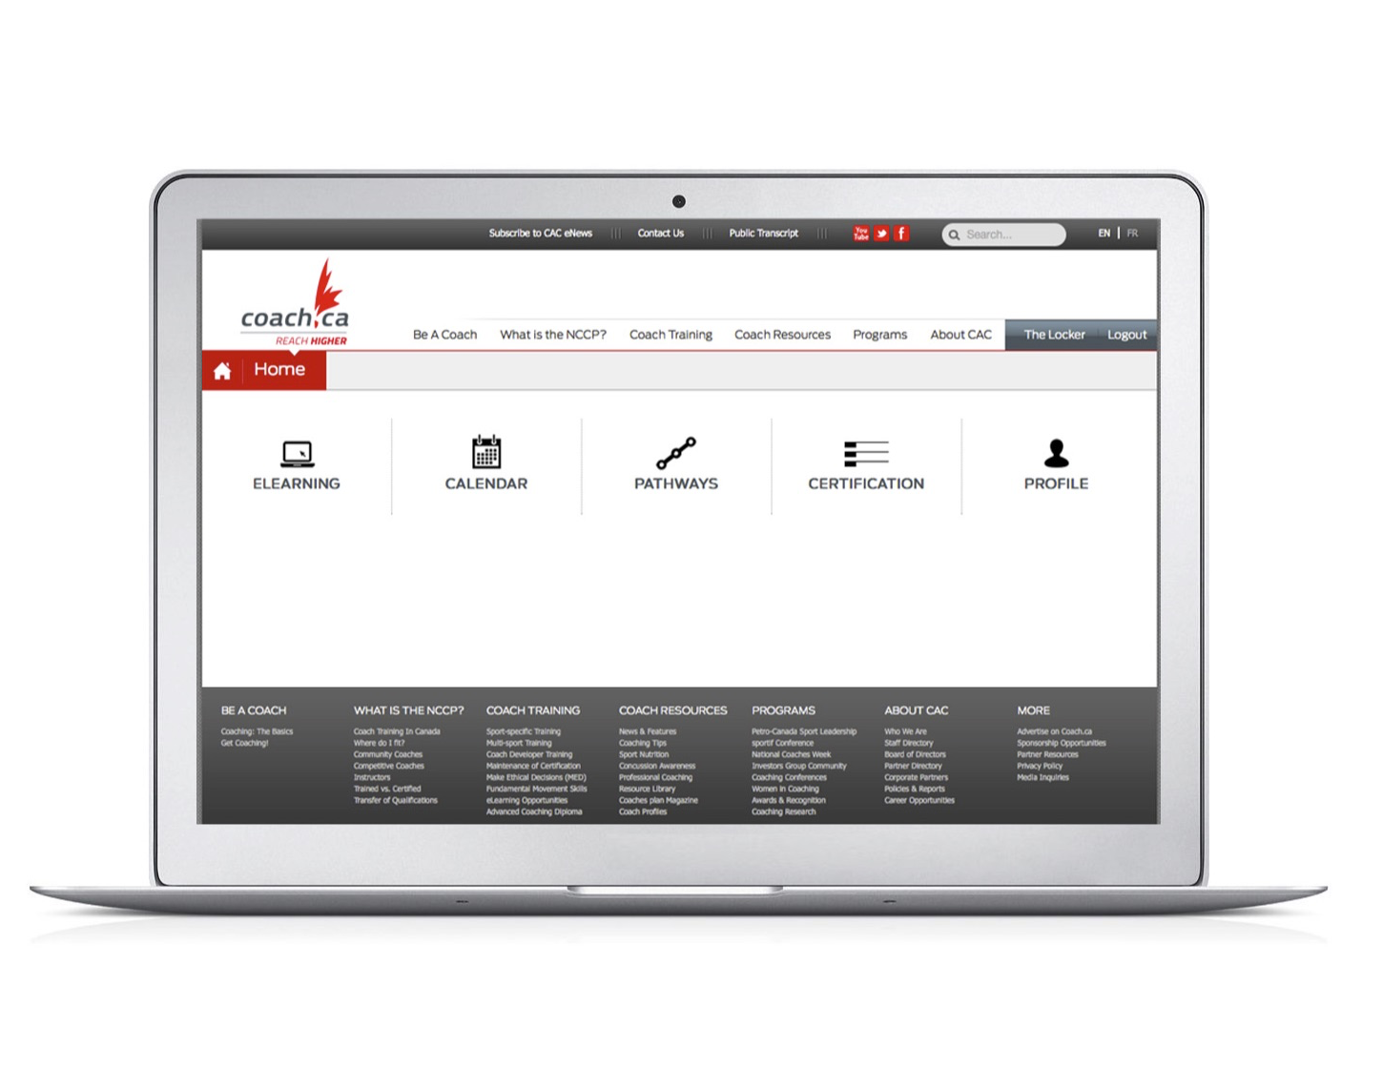
9

Slide 10
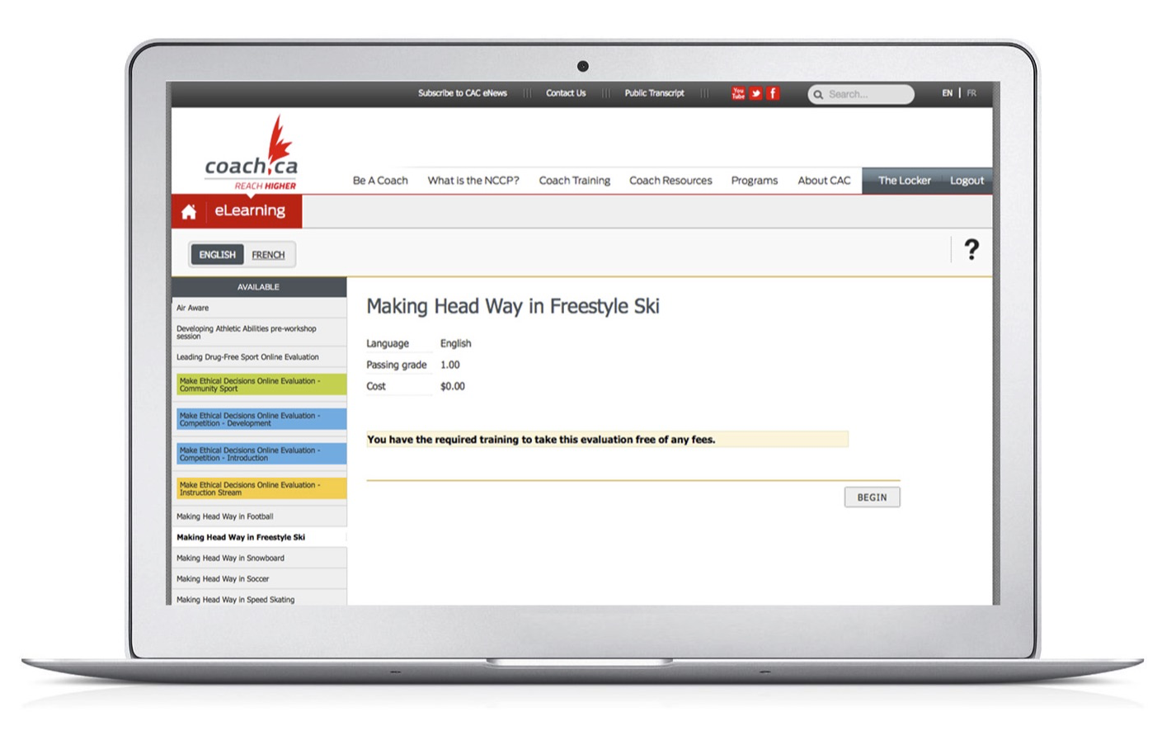
10

Slide 11
11

Slide 12
Modules outcomes
After completing this module you will be ready and able to:
Understand the event management and decision making structure
Be prepared to help in a variety of minor official roles at the event
Have more fun as a volunteer, knowing you are part of a large team and by better understanding your role before you hit the slopes!
12

Slide 13
Partnership Proposal
13
Officials
There are 3 categories of Event Officials
Management Officials (we will briefly touch on this in level 2, but much of Management will be in level 3)
Support Officials (YOU taking this course! Thanks!)
Jury Officials or the Major Officials collectively (these are your most experienced officials at an event)
13

Slide 14
SAFETY and RISK MANAGEMENT
An Event Officials (minor, major, admin or management) PRIMARY responsibility is the safety of all
Competitors
Coaches
Volunteers
Officials
Judges
Event crew
The host resort
The general public
SAFETY MUST FACTOR INTO EACH AND EVERY DECISION MADE
14

Slide 15
THE EMERGENCY ACTION PLAN
While it is not expected that you will have input into WHAT the EAP or Emergency Action Plan is, you will be expected to carry it out…
The Chief of Comp and the Event Director, along with the Chief of Course will have all these details mapped out months in advance with the local emergency care providers and the host resort
15

Slide 16
Partnership Proposal
16
Organizing Committee Members
Leadership in Officiating & Event Management will be in the Snowsports Officials Level 3
.
16

Slide 17
Organizing Committee & Event Administration
Responsible for all communications and ensuring tasks are completed for their area of responsibility
Liaison between host resort, partners and other event committees
Overall coordination for the planning, organizing and staging of the event
TIP!
It is critical for a smooth running event that the Administration Team is kept up to date with the latest developments.
AND
The Admin Team must be able to have effective 2-way communication with the competition department who are outside.
17

Slide 18
Management Officials
Chief of Competition
Is in charge of all aspects of competition venues, field of play, scheduling and outlining volunteer requirements
Event Chair
Chairs meetings, has the final say in administrative process
Event Coordinators
Off hill based, accommodations, transportation, social, awards/protocols, volunteers
Event Secretary/Treasurer
oversees the admin side of event, coordinates minute keeping & provides updated financial statements at each meeting
18

Slide 19
Administration Personnel
TIP! Determine your NEEDS early, for both on the hill and off hill
Where do all these people come from??
Recruit within your club, past and present
Go to your PSO
CFSA database
Public recruitment, use your websites and social media to get the call out
Event specific orientation sessions…plan for a debrief session afterwards too!!
Engage through ongoing communications….emails, websites and blogs are great for capturing the passion!
19

Slide 20
Your Organizing Committee Members & Incredible Administration Team at a glance!
Committee Members and Admin staff at many events will comprise the following roles
Chairperson
Accommodations Coordinator
Athlete Services
Ceremonies Protocol Coordinator
Communications Coordinator
Competition Secretary
Equipment Coordinator
Finance Coordinator
Marketing Coordinator
Medical Services Coordinator
Media Coordinator
Officials Coordinator
Registrations Coordinator
Results and Scoring Coordinator
Sponsorship Coordinator
Host Resort Coordinator
Technical Operations Coordinator
Transportation Coordinator
Volunteer Coordinator
20

Slide 21
Support Officials (YOU!!)
Are willing to be Team Players
Will be task oriented and are primarily responsible for only one area of the event
Can be minor decision makers, and act as the eyes and ears for Major Officials
Will have completed Volunteer Orientation (Level 1 course) at snowsportsofficials.com
21

Slide 22
Major Officials
You will report to Officials that:
will demonstrate through their actions and prior event experience, role model behaviours and mentorship
Have broad based management and supervisory skills, and they will be keeping in mind you are volunteers
Have a deep knowledge of the rules, regulations and terrain guidelines
Have a strong understanding of the Organization surrounding Event Management & Competitions
They are the major decision makers for the competition
22

Slide 23
Partnership Proposal
23
COMPETITION JURY
Who are the major officials and how they make decisions
.
23

Slide 24
Competition Jury consists of the following individuals
Technical Delegate (Chair of the Jury, also has the Veto vote)
Chief of Competition
Head Judge
24

Slide 25
The Jury is usually 3 in number and consists of highly experienced Officials
The Jury monitors the Official Training and The Entire Competition to ensure compliance with the rules governing event
This is achieved by:
Inspecting and monitoring the entire field of play, and the event venue areas constantly (we’re outdoors here folks!)
Overseeing the course work, always with a focus on safety and fairness
Determining the start and ending of Official Training, and the Competition times; especially taking into consideration weather, snow conditions, time of day, number of competitors, experience level of athletes and level of competition
25

Slide 26
Determining the number of and start order of forerunners
Granting provisional re-runs and re-runs as required
Interrupting or terminating the competition (weather)
Announcing any disqualifications, and any disciplinary measures or sanctions
Rule on protests
26

Slide 27
Duties and Obligations of the Jury
Apply and ensure fair and uniform application of the Rules
Jury members may cancel, postpone or interrupt the competition
Jury members supervise the athlete draws, and they attend all Team Captain’s Meetings
Jury members will inspect all areas of the course, measurements of the courses are done by the Jury
The Jury will rule on protests and any reruns in an event
The Jury will supervise Official Training
The Jury is ultimately responsible for ensuring that training and competition is
RUN SAFELY & FAIRLY for ALL PARTICIPANTS, EVENT STAFF, OFFICIALS, VOLUNTEERS, THE HOST RESORT & EVENT PARTNERS
27

Slide 28
The Technical Delegate (most often called the “TD”)
Represents the National governing body and/or FIS depending on level of competition
Ensures that the event is run in a safe and fair environment
Attempts to ensure that the event runs seamlessly
Acts as technical consultant
Acts as Chair of the Jury, and has the Veto vote
Must attend all Team Captains Meetings, and act as a resource for the Competition Committee
Advises the organizers on compliance with FC/FIS Rules
Inspects and measures all course prior to the first day of official training
Arrives at the location at least 24 hours before the beginning of official training
28

Slide 29
The TD
Reads the report of the Technical Delegate of the preceding competition, and for the last event held at that resort
Is present at all times during training. Observes athletes on runs, is looking for hazards constantly
The TD is responsible for completing a final report to the PSO/FC/FIS and the host committee along with the host resort
The TD is also responsible to inspect all technical installations including the judges stand for safety
The TD will advise the organizers on issues around the training and competition schedule
29

Slide 30
The Head Judge
Is responsible for over seeing the work of the panel of judges
Is required to attend all Jury meetings and necessary pre-event course inspections
Coordinates the transportation, accommodation and expenses of the individual judges
Is required to attend all Team Captain meetings, commencing with the TC meeting on the eve of the final day of Official Training
Responsible to ensure all necessary judging tools are provided
Head Judge is responsible for inspecting the judges stand and surrounding areas, for the purpose of approving its suitability, visibility onto the course, location and safety
The Head Judge is there to ensure the professionalism of the panel is upheld
Head Judge reports back to the PSO/FC/FIS/AFP
The Head Judge is instrumental in the running of an “on schedule event”
30

Slide 31
Chief of Competition
Manages ALL aspects of competition inside the field of play
Acts as Chair for all Team Captain Meetings
Ensures courses meet appropriate terrain guidelines and specifications
Develops the schedule for pre event and the competition schedules
Oversees all officials and volunteers
Works with the Organizing Committee Chair and is responsible for all technical aspects of event
The “Chief of Comp” typically is happy for event day to arrive, so they can enjoy all the hard work come together! and to watch the athletes go all out on “their” venues
31

Slide 32
*The Race Director
Attends FIS World Cup, FIS NorAm, Canada Winter Games, Canadian Junior Championships and Canadian Championships
Reports directly to FC and/or FIS
Advisor to the Jury
Responsible for verifying quotas and athlete entries
*A Race Director is usually seen at higher end competitions such as FIS events, Canada Games, Junior & Senior National Championships
32

Slide 33
Events & Competition Sites
Please see the Freestyle Canada Terrain Guidelines for all the details through the LTAD process, but know there are:
FIS Specific Guidelines for NorAm, and World Cups, Sr. Championships
Freestyle Canada Specific Guidelines for COT, Canada Cup, Junior National championships
Each Province/Territory may have unique Provincial/Territorial Specific Rules for Provincial Series and Timber Tour Events
Club Specific for Jumps & Bumps and Freestylerz events
33

Slide 34
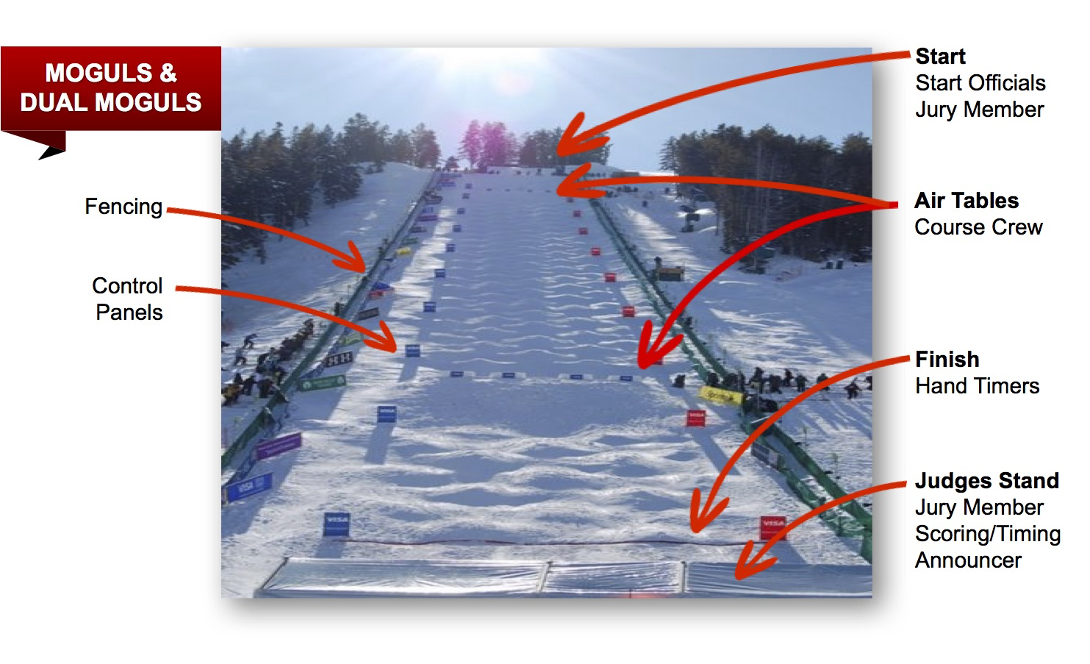
34

Slide 35
35

Slide 36
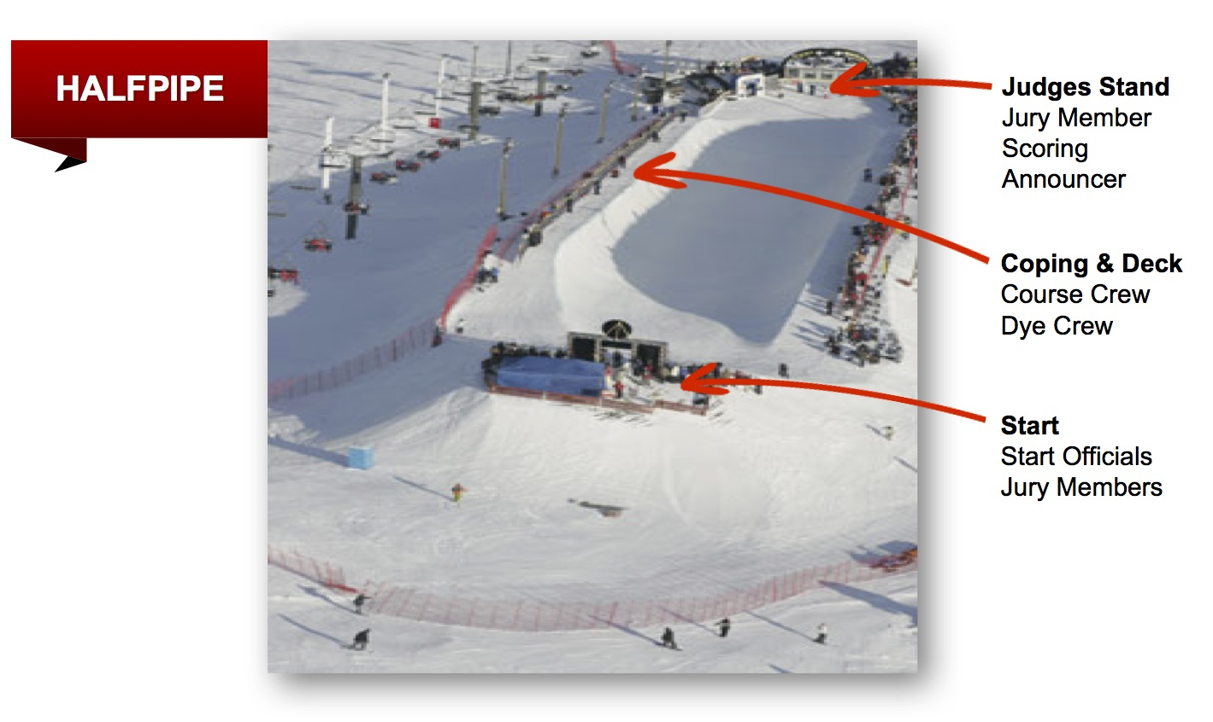
36

Slide 37
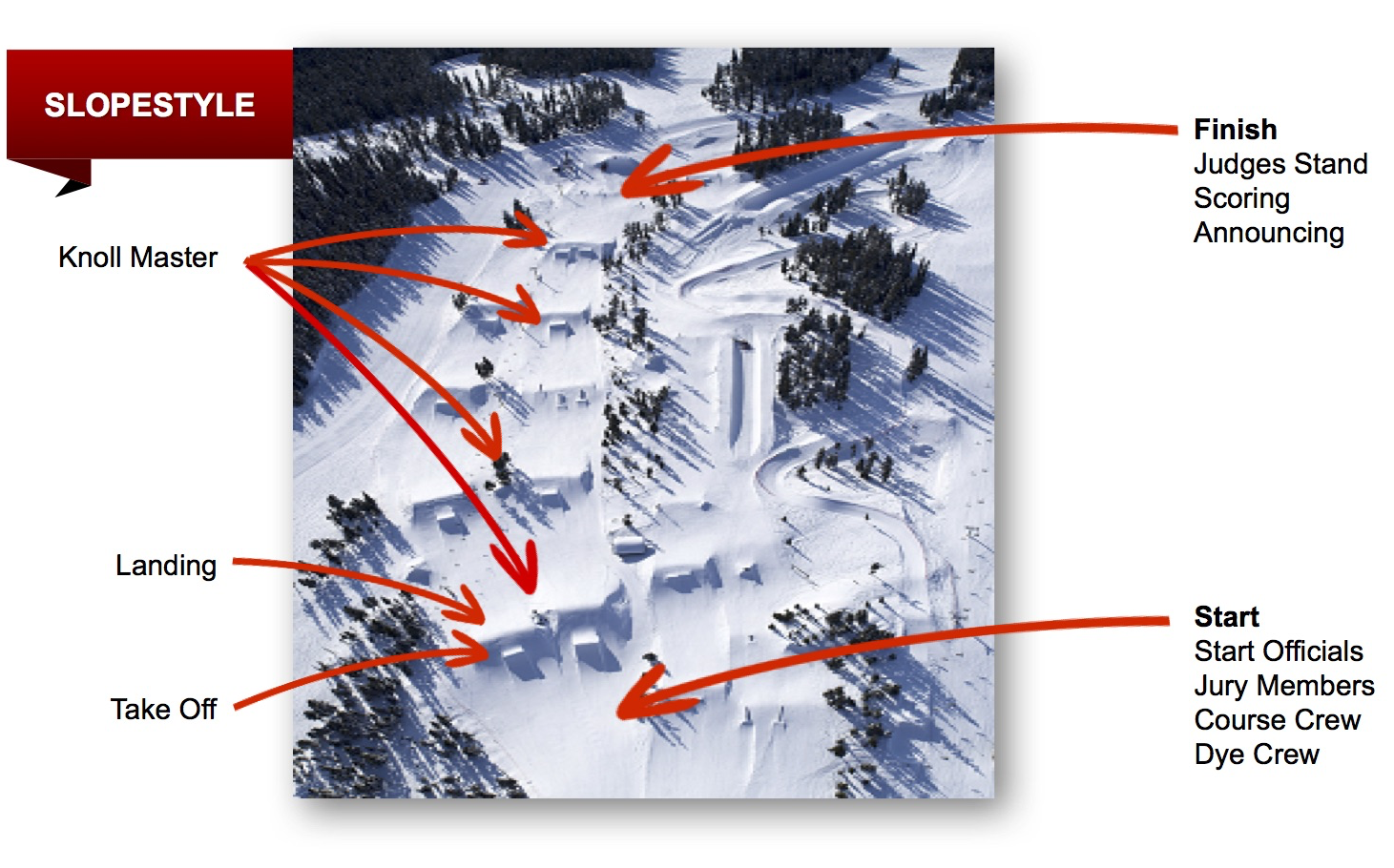
37

Slide 38
38

Slide 39
Partnership Proposal
39
OFFICIALS, EVENT ROLES AND RESPONSIBILITIES
39

Slide 40
Support Officials who are working outside!
You will be outside, and anything can happen in a long day! so key points to remember!!
CUTE = COLD! so dress in layers, and have extra, additional warm layers, mitts and hat with you
Have hand warmers, water and a snack with you…you don’t want to miss any of the fun!
Have something to write with, sharpies and hiliter pens work best in cold wet weather, pencils don’t work on wet paper
Know what your role is before going outside, and WHO it is that you report to, and where they will be on hill
40

Slide 41
Support Officials who are working outside!
Before going outside, make sure you have all the tools you need to do your job
(its no good to show up as the assistant starter without any start lists, for example)
If you are working as a course crew member, its great to have a pack with all the above, and some cable ties, duct tape, a multi tool or side cutters as you could be working on stringing fence/timing cable/extension cords, talk to the chief of course or chief of comp, especially if you are there multiple days
There are lots of tricks to being a great volunteer, ask your OC, Chief of Comp or the person you report to for hints, we want this to be an enjoyable and awesome experience for you
41

Slide 42
Assistant Starter
Line up competitors according to published start lists (make sure you grab extra copies BEFORE going outside)
Assist the starter in organizing and supervision of the start area
Assist in determining any bib changes and late competitors (let starter know earlier than later someone is missing!)
Be able to communicate to the Jury through the Chief of Start by their radio if a decision needs to be made with your input
Reports to the Chief of Start
42

Slide 43
Assistant Starter
TIP!
This role is outside for the day, ensure you are dressed more warmly than you normally do, often you are in the wind at the top, or you are in the sun, and the finish is in the shade
Bring a sharpie type marker or hiliter pen (great in wet, pencils rub through wet paper) to keep track of athletes and to make notes on your start list, if its wet, or snowing, plastic page protectors are awesome, and a clipboard (not metal)
A piece of foam or a chunk of carpet is nice to stand on, gets you up off the snow
43

Slide 44
Awards and Prize Giving
Manage the award ceremonies following applicable protocol (have VIP, or host resort on hand to present)
Create the prize and/or medal inventory well in advance, it can take longer than you think to get medals/awards
Coordinate the awards categories before the ceremony, have them laid out in order of presentation
Prepare the prizing for the awards, working with the VIP coordinator
Reports to the Event Director
44

Slide 45
Assistant Chief of Course
Able to assume and fulfill role of Chief of Course as needed
Ensures that courses are properly prepared for training and competition
Ensures that the appropriate tools, supplies and equipment are available to course crew, and knows where they are!
Coordinates with Chief of Course and Chief of Competition to ensure course crew have the days instructions of work and maintenance
Must have previous event course crew experience, preferably on the type of venue competition is held on
45

Slide 46
Assistant Chief of Course
Must be capable of guiding and communicating instructions to course crew
This is a position that requires you to be outside all day, and you need to be really prepared! Knowing your tool inventory and position is critical, have drill batteries charged, dye or paint warm, pine boughs chopped and ready to go
Reports to Chief of Course
46

Slide 47
Assistant Chief of Competition
Assume and fulfill responsibilities of the Chief of Competition as needed
Ensure that the competition is conducted under the event standards and all rules and regulations are applied
Ensure that all teams and officials are kept informed and up to date about all aspects of the competition
Work closely with the volunteer Coordinator for scheduling and venue requirements
Work closely with the Chief of Course to ensure proper field of play preparations are in place for training and competition
47

Slide 48
Assistant Chief of Competition
Must have prior event experience (preferably in a Chief of Course role), strong working knowledge of event delivery
Must be capable of guiding and communicating instructions to course crew and volunteers
This is a great learning step, you can take this roles experience back to your home resort and be a Chief of Competition at a local or regional event
Reports to Chief of Competition
48

Slide 49
Announcer
A great announcer can make or break an event, this is the “event’s host”, they need to be bigger than life and really lively. Literally the announcer can be the face (the voice) of your event!
Remember to keep it positive, comments like (“oh too bad”, “that sucks to fall there”, “I bet she wishes she could have another attempt at that” “I know they can do that trick”) hurt the athlete, and may even influence some inexperienced judging panels ….(believe it or not)
Be aware of different protocols on announcing for the different events (when to talk and not talk during a run for example)
During Dual events, you are literally the only way everyone knows who moves onto the next round!
Runs and coordinates the event music playlist (keep it PG!) there’s nothing quite like an “F-bomb” at 110 decibels reaching across your host resort to get people fired up!
49

Slide 50
Announcer
Comment on an athletes run (keeping it positive!!)and share background info on athlete – be certain announcer knows and can pronounce names
(Bios should be provided in a binder, in RUN ORDER from Start List, before going outside in the wind, snow, wet) Must have strong trick/discipline knowledge to get crowd engaged
Share ranking information and special announcements for the event, keep crowd and course crew informed!! Announce scripted material provided by the LOC in regards to sponsors, special mentions, and VIP’s
Inform spectators about the event, how they can become involved, announce the place and time for awards. Explain to crowd on what they are watching, how the different event formats work, what the athletes are attempting to do, how scoring works.
50

Slide 51
Announcer
Must be able to communicate strongly, clearly (good voice) and be able to improvise quickly. For National events with athletes from across Canada attending, bilingualism is required
TIP!
Get athlete Bios sorted out inside, have extra start sheets, page protectors, have highlighters or sharpies to write with, have hand warmers and “iPod” with charger, even a backup “iPod” and charger is a good idea, know the day before how sound system works, know who the Chief of Competition is, you MUST have a radio to pass along important messages, this can be a stationary outside position, so dress really warm, the MIC is always cold, so have hand warmers or really big warm mitts, you can help out by getting everything set up early, nice to have tunes to work by!
Reports to the Chief of Competition
51

Slide 52
Chief of Competition (Jury Member)
Coordinates the Local Organizing Committee (LOC) Meetings
Ensures that all aspects of the competition, including courses, are appropriate to the level of competition
Ensures that all applicable FC/FIS ICR Rules & Regulations are followed
Supervises and directs the work of all officials, volunteers and course crews
Ensures that all teams and officials are informed and kept up to date about all aspect of the competition
Acts as Chairman of the Team Captain’s Meetings
Must have previous event experience as an Assistant Chief of Competition
Must be impartial, creative thinker, strong decision maker and able to communicate effectively to volunteers, officials, course crew and teams
Works with the Event Director
52

Slide 53
Chief of Equipment
This is a key support role!
Chief of Equipment is responsible for obtaining, and supplying of all equipment, tools and materials for the preparation, construction and maintenance of the course and venues (everything from zip-ties and paint to sound system and scaffolding)
Must be able to communicate clearly and quickly, work within a limited budget
This is your events “GO TO” person, this person should be able to:
Think quickly, act faster and anticipate what may be required before it is needed, and figure out how to get it there in 1 minute or less
53

Slide 54
Chief of Course Equipment
Operate under a high level of stress, as everyone will need their wants fulfilled yesterday
Ideally is ½ MacGyver, ½ Radar O’Reilly
(if they can build you a generator out of peanut butter and a Leatherman tool without using duct tape or zip-ties even better)
Reports to Chief of Competition
54

Slide 55
Course Crew
Responsible for the use of all tools, equipment and supplies provided to them to prepare and maintain the course and venue for the duration of training and competition
Responsible for operating the event in a safe manner for the athletes and, considering not only themselves, but other officials and course crew, spectators and host resort guests and employees
Be part of a team that is responsible for a given section of the course, ensuring that all maintenance aspects are dealt with, and oversee the raking, shovelling, dyeing/pine bough/marking, fencing, and marshalling of that section is completed
55

Slide 56
Course Crew
Must have an effective way of communicating directly to the Chief of Course
Must be capable and comfortable carrying heavy, awkward loads on snow
Reports to the Chief of Course
TIP!
This is an outside, really long day position. You have the best seat in the house as a reward! This is a fantastic “first time” position, so early and often communication with your Chief of Comp and Chief of Course is essential to you having a great event day
56

Slide 57
Chief of Scoring
This is a Very Key Role!
Responsible for the correct operation of a variety of software scoring programs, most ‘SCORERS” use the WINFREE & AFP systems
Need to be VERY comfortable with scoring programs, Excel formats and able to focus for long periods of time (think accountant!)
The Scoring Role is outside of this course, but if the above sounds interesting, start in an assistant role and mentor your way up!
57

Slide 58
Chief of Start
Directly responsible for the start area from the commencement of Official Inspection until the end of the days schedule
Ensures that all start rules are followed
Organizes the start area with the Assistant Chief of Start, course crew and Assistant Chief of Course
Determines and reports late athletes, no-shows, false starts and other infractions to the Jury, indicating athlete names, bib number, start number. Must not proceed until directed to do so by a member of the Jury or the Race Director
Must be able to communicate immediately at all times with the Jury by radio
Must be a clear speaker, with authoritative, firm yet calm tone
58

Slide 59
Start sequence is as follows…
The timing and scoring will (hopefully) be on another radio channel, and Chief of Timing will inform Head Judge the timing crew are “ready”, so you are waiting for…“Judges are Ready, PROCEED”
Off the radio, you will ask first if the athlete is ready, then once they have nodded or indicated yes, press your mic button, “BIB #______! ATHLETE READY! 3, 2, 1 GO!” for slope and pipe events substitute “3,2,1 GO!” with “dropping in!”
Reports to the Chief of Competition, may deal directly with timing or scoring on certain matters
TIP!
Go over Event start protocols with the TD, Head Judge, Chief of Competition BEFORE heading outside!
59

Slide 60
Chief of Start
This is a long outside day without many opportunities for breaks... so come prepared, and bring everything you might need for the day…you are often at the top of the hill, so weather can be unpredictable, and windy.
You will be talking into a MIC all day, so ensure you have access to a back up radio, bring extra start sheets and markers, and extra hand warmers.
The athletes are really focused, so it is important to be able to communicate with them, but allow them to stay in the zone.
60

Slide 61
Chief of Course
Directly oversees the preparation and maintenance of course for training and competition
Maintains course specifications according to Freestyle Canada terrain guidelines and/or FIS ICR
Is directly responsible for the safety of all athletes, officials, coaches and course crew
Selects course access points for course crew and ski patrol
Oversees the competition field of play, ensuring the following days requirements are noted and satisfied. MUST know where all equipment is on course and what the status of it is. MUST work closely with Chief of Equipment.
61

Slide 62
Chief of Course
Directly supervise the course crew, coordinating with Chief of Course Equipment, any logistical requirements
Attends all Team Captain’s meetings, acts as an advisor, solicits feedback from coaches or the Connection Coach and creates action plan for course crews based on coaching input
Must be familiar with the local host resort, terrain and snow conditions
Must be a quick decision maker, someone that can delegate under pressure and guide a crew of experienced and inexperienced course volunteers
Must have experience prior as assistant chief of course, and reports to Chief of Competition
62

Slide 63
Chief of Timing
This is a very key role. It is important the Chief of Timing has the ability to communicate to Jury members by radio; the Head Judge on a separate radio to commence the start sequence; and to the Chief Of Competition in case any issues arise
Responsible for the installation and supervision of all timing equipment
Ensures that the timing system is adequate to the level of competition, as this varies
Ensures the full functioning of the timing system the day before competition and has in place a backup system, ensures there are backups to the backups, and has plenty of fresh batteries required for system.
Ensures that the type and positioning of the timing hut is safe and adequate
63

Slide 64
Chief of Timing
Coordinates the officials at the start and finish line
Supervise the duplication of unofficial results
Must be competent on the type of timing system being used for the competition, at Provincial and Canada Cup events, this is not the time or place to “learn on the fly”
Must be able to troubleshoot independently, and clearly communicate instructions by radio or cell phone
Reports to the Chief Of Competition
This experience and competency based role is outside of this course, but if you have an aptitude for electrical systems, this is a great role!
64

Slide 65
Communications Coordinator
Creates a multi faceted communications plan for the entire event, conforming to CFSA Guidelines and Standards
Communicate the plan with LOC/PSO/FC so it can reach as many in the sport community as possible
Write and publish press releases for the event (pre-event, during and post-event)
Organize media availability, inquiries and access to event
Ensure social media presence
National and International events will need bilingual person to fulfill this role
Must be at ease dealing with the media, and communications
Reports to the Event Director
65

Slide 66
Course Crew CHOPPERS
Labour intensive role, first on the course and last off
Very important for athlete (your kids) safety that the chop is done properly!
“Chop” is best performed from the bottom, working towards the top
Work in a line moving together, so that no area is missed in the landing
“Chop” needs to be a minimum of 1 ½ shovel blades deep
66

Slide 67
Course Crew CHOPPERS
TIP!
Even though you aren’t moving very quickly, its VERY easy to become overheated. Be careful moving around the “chop area”!
ALWAYS shed some layers and your helmet BEFORE starting the chop, leave on top of table, you will sweat and don’t want to be cold for rest of day
Have some water with you, this is a hard job!
67

Slide 68
Course Crew FENCING
Responsible for working with course builder and Chief of Competition to erect all fencing around the field of play
Work with host resort for the erection of safety fencing or netting and safety pads
Set up banners, tents
Must be able to work independently and as a team member
Must be able to carry heavy and awkward loads over terrain
Reports to Chief of Course
68

Slide 69
Course Crew FENCING
TIP!
Outside job that can be long, especially leading up to event.
Come prepared to spend the day outside, with lots of water and snacks, and have “work gloves” as you’ll destroy your good ones.
Pick up a pair of cheap side cutters for clipping zip ties,
Dress in layers, as you’ll go from sweating like crazy to standing still in a wind quickly, you will work in a team, following the lead of the chief of course, this is a great “first time’ job, or one to grab if you can’t make event day, this is a fun crew to be on!
69

Slide 70
Course Crew MARKING
Responsible for the creation of an inventory of dye mixtures, pumps, and ensuring their proper working order at all times
Responsible for creating an inventory of pine bough and having at starts and air tables, and having an extra backup stock
Marking the course so athletes have a fair and safer course with changing light conditions
Outlining terrain features and landings with direction from the Chief of Competition and TD
70

Slide 71
Course Crew MARKING
Must possess the ability to schedule lead a crew, often with tight timelines
Must be a strong skier/rider who can carry heavy loads comfortably on steep landings, awkward slopes
Reports to the Chief of Course
TIP!
Bring old work gloves, don’t wear your new pants, they will get blue. This is usually a fast paced “hurry and wait” position.
Need to be able to go at a moments notice if there is a break in the event or the weather dictates fresh markings.
You can get overheated quickly running up landings, so plan your work route out
71

Slide 72
Course Crew Slippers and Steppers
Ski or ride down the course moving snow to the sides, ensuring a clear course for the competitors
Ensure the slippers and steppers receive clear instructions prior to starting down the course
Ensure that the field of play is clear of debris, and hazards, including “cookies” and mounds of snow, and any big landing holes are filled in and stepped/slipped out
It is important for the slippers and steppers to be aware that the course may remain open while they are on course
Required to be strong skiers and riders
Reports to the Chief of course
72

Slide 73
Course Crew SLIPPERS AND STEPPERS
TIP!
Even though you may not be moving fast, you can quickly become overheated, especially with lots of new snow, so layer up,
Be prepared to have someone from your crew bring clothing to the bottom
73

Slide 74
Event Director
Responsible for all administrative functions of the event
Coordinates budgets and works with event secretary/treasurer to ensure event stays on budget
Establishes and monitors event timelines and schedules and ensured deadlines are met
Negotiates and secures required meeting spaces, fields of play with host resort
Coordinates the event logistics, including athlete registrations and volunteer tracking, event presentation materials, and supports pre and post event evaluations
Must have strong management skills, excellent leadership qualities, great organizational skills and be able to communicate effectively with a large organization, most of whom are volunteers; many for the first time
Submits written report to PSO/FC
74

Slide 75
Event Office and Admin Support Crew
First point of contact for athletes, coaches, parents, officials and visitors to the event, think of this crew as the events “ambassadors”
Responsible for the registration of teams/athletes, collecting of fees, bib deposits, waivers, and athletes package distribution
Communicates with Event Secretary and Chief of Scoring updated changes to event registrations
Assists Volunteer coordinator with volunteer check in
Assist and direct athletes with information requests about the host resort, host community and event
75

Slide 76
Event Office and Admin Support Crew
Assists with scoring in posting results
Assists the Admin team as directed
Ensure the event office is appropriately staffed, has necessary supplies, and area is clean and functional
Assist in coordinating the event awards ceremonies
Reports to the Event Director
76

Slide 77
Runners
Assist the Chief of Course with last minute errands between Course and Administration or Equipment office
Assists Head Judge with running scores to the scorer if not on judges platform together
Assists wherever and whenever
Must have a good working knowledge of host resort to move efficiently from one area to another
Reports to Chief of competition
TIP!
This is a great first time position that can be filled by an athletes sibling who knows the host resort, and is mature enough to quickly follow complex instructions
77

Slide 78
Gate Crew
Ensure the gates and control panels are assembled and ready for placement at the top of course when required
Working with the TD, Course Setter or Chief of Competition to place gates where indicated in the proper manner
Ensure that extra panels are available in case a replacement is necessary, Chief of Course decides where these will be
Must be able to ski/ride moving awkward loads over varying terrain
Reports to Chief of Course
78

Slide 79
Gate Crew
TIP!
Even though you aren’t moving very quickly, its easy to become overheated.
Having some zip ties, duct tape and a multi tool along are great, some gate panels get pretty beat up.
Always carry an extra battery for your drill, you’ll usually be in a team of 3-4 and work takes place at the beginning and end of day, so this is a good job to hand off to course crew if short on volunteers
79

Slide 80
Hand Timers
Responsible for the consistent operation of stop watches as the back up to the electronic timing system
Keep track of athlete bib numbers for correct time results
You will need a radio to communicate your times to the Chief of Timing
Follow the directions of the Chief of Timing, including the assistance in preparing and marking start and finish lines, and assisting with timing eyes as required
Report to the Chief of Timing
80

Slide 81
Tips for Hand Timers
Practice many times inside with your crew and the Chief of Timing on how to use your stopwatches, and how to reset them.
This is an outside day long position, where you move very little and concentration is required over a full day.
The best part is you are part of a small 3-4 person team, and you get to watch every athletes run.
You need to bring with you everything you will need for the day, as break opportunities are limited. Bring lots of layers, many folks will wear winter boots, but be mindful you need to get your feet back into your ski boots at the end of the day, the “one use” full length foot warmers are awesome too.
81

Slide 82
Tips for Hand Timers
A small glove you can wear inside one mitten is good, hand warmers are essential.
Sunglasses and/or goggles are important, as in order to stay warm, you will be placed facing into in the sun many times.
Make sure that either a plywood deck or carpet is available to stand on, a piece of blue foam or the interlocking foam mats work well to in a pinch, you will need to be on a level surface to avoid leg fatigue.
82

Slide 83
Race Secretary
Ensures that all the necessary and required secretarial work for the technical aspects of the competition is completed according to the standards that the event dictates
Prepares the Draw and start lists according to the competition format and the FIS ICR and appropriate rules governing event
May assist the TD with the minutes of the Competition Committee, Jury, Team Captain’s Meetings and completing attendance lists
Ensure all forms required for competition including the start, finish, timing are prepared in advance and distributed to the appropriate officials
83

Slide 84
Race Secretary
Cooperate with the calculations and results vetting process, and ensure that they are copied and distributed as needed
Submit results once approved by the Jury to the LOC, PSO, FC, FIS
Must have good computer skills and be highly organized
Reports to the Chief of Competition
84

Slide 85
Sponsorship and Marketing Coordinator
Prepares and coordinates the implementation of the marketing and advertising strategies
Communicates the plan to the LOC/PSO/FC
Build and maintain relationships with past and present sponsors
Participate in the event day marketing and branding of the event
Works closely with the Communications Coordinator
85

Slide 86
VIP Coordinator
Prepare in collaboration with the Prize and awards coordinator the required accreditation, lift access and welcome packages
Oversee the setup of the VIP areas
Acts as the contact for all VIP’s throughout the event
Must be quick thinking, diplomatic, resourceful and courteous
Reports to the Event Director
86

Slide 87
Volunteer Coordinator (aka the miracle worker)
Coordinate and oversee that all required workforce positions are fulfilled by competent and qualified people
Recruit and assign the workforce as appropriate to the level of competition. There are some great templates available, talk your LOC or PSO for help with this.
Works very closely with the entire LOC, but especially the Chief of Competition and Event Director
Coordinates any pre-event training sessions required for volunteers and course members
87

Slide 88
Volunteer Coordinator (aka the miracle worker)
Coordinates volunteer accreditation, check in, training and to whom they will report
Coordinates volunteer needs, including lunches, water, break/rotations
Must be flexible in working with Chief of Competition to re-assign volunteers as required by event demands
Reports to the Chief of Competition
TIP!
This awesome individual needs to be really organised, & not be afraid to ask anyone and everyone for their help with the event.
Contact your PSO and/or FC for some great templates.
88

Slide 89
Partnership Proposal
89
Thank you! See you on the slopes!
89

